Slide 1


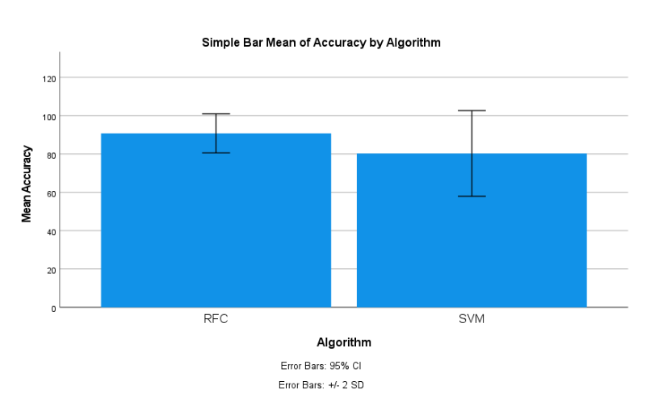
Students Name: A. Ajay
Registration number: 192124147
Guided By: Dr. R. Dinesh kumar
Ms. Poorani.S
Guided by Dr. Mary Valantina. G
Stock Market price prediction using Long Short-Term Memory (LSTM) in combination with svm
Leveraging LSTM and SVM: LSTM is a type of neural network specialized in processing sequences of data, making it ideal for analyzing time-series data like stock prices. SVM, on the other hand, is a robust machine learning algorithm known for handling complex patterns and high-dimensional data.
Combining for Enhanced Prediction: By combining LSTM and SVM, we aim to capitalize on their respective strengths. LSTM captures time-dependent patterns in stock market data, while SVM refines these patterns into effective predictive models, leading to more accurate forecasts.
Data Processing and Feature Extraction: LSTM processes historical stock market data to extract relevant features and learn patterns over time. The output from LSTM is then fed into SVM, which further refines the feature representation to improve prediction performance.
Goal of the Study: Our goal is to develop a hybrid LSTM-SVM model that surpasses traditional forecasting methods..
INTRODUCTION
Fig 1:Stock Market Prediction
MATERIALS AND METHODS
Data Cleaning:
Remove or correct any errors or inconsistencies in the collected data to ensure data quality.
Depending on the dataset, search for duplicate rows using all or a subset of the columns.
Data Preprocessing:
Handle missing values: Impute missing values using mean, median, or mode.
Handle outliers: Identify and handle outliers using techniques like Z-score, IQR, or removing them.
LSTM Model:
Define the logistic regression model.
Train the model using the training set.
Calculate accuracy, precision, recall, and F1 score to measure the model's effectiveness.
Data Collection:
Data was collected on perpetrator attacks.
Preprocessing the data, including cleaning, transforming, and encoding.
Results:
Data was analyzed and used Logistic Regression in comparison with the Decision Tree Algorithm.
Accuracy of 85 percent.
Conclusion:
Summarize the findings from the analysis.
Conclude the effectiveness of Logistic Regression and Decision Tree algorithms in predicting perpetration attacks.
SVM Model:
Define the decision tree model.
Train the model using the training set.
Calculate performance metrics such as accuracy, precision, recall, and F1 score.
Stock Market Prediction
RESULT
 | Levene’s Test for equality of variance |  |  |  | T- test for equality of means
 | F | Sig | T | DF | Sig | Mean | STD. Error | Lower | Upper
Equal variance assumed | .787 | .361 | 5.676 | 18 | <.001 | 0.8000 | .01409 | .05039 | .10961
Equal variance not assumed |  |  | 5.676 | 16 | <.001 | 0.8000 | .01409 | .05025 | .10975
Fig 2:LSTM and SVM
Table 1: Independent Sample Test
DISCUSSION AND CONCLUSION
Enhanced Prediction Accuracy: The combined model improves prediction accuracy by leveraging LSTM's ability to capture temporal patterns and SVM's feature refinement capabilities.
Interpretability and Insights: Analysts can gain valuable insights into stock market trends and drivers of price movements, aiding in decision-making and risk assessment.
Robustness and Scalability: The hybrid model exhibits robustness and scalability, making it suitable for diverse market conditions and investment strategies.
Real-World Applications: The LSTM-SVM approach has practical applications in financial markets, offering a powerful tool for investors, traders, and financial institutions.
The combined LSTM-SVM model holds promise for enhancing stock market prediction accuracy, thereby empowering investors and analysts to make more informed trading decisions.
While no model can perfectly predict stock prices due to the inherent unpredictability of financial markets, the combined approach offers a valuable tool for mitigating risk and optimizing trading strategies.
BIBLIOGRAPHY
Hochester, S., & Schmidhuber, J. (1997). Long short-term memory. Neural Computation, 9(8), 1735-1780. Link Vapnik, V. N. (1995).
The Nature of Statistical Learning Theory. Springer. Palit, A., & Popovic, D. (2020). LSTM and SVM based Stock Price Prediction using Financial News Sentiments.
In Proceedings of the 2020 IEEE/ACM International Conference on Advances in Social Networks Analysis and Mining (ASONAM) (pp. 828-835). IEEE.
Zhang, Z., Salzmann, M., & Poggio, T. (2017). Perceptual learning: toward a comprehensive theory. Annual Review of Psychology, 68, 605-632. Li Sun, Y., Zhang, J., Huang, Y., & Wang, J. (2019).
Stock price prediction using attention-based multi-input LSTM. IEEE Access, 7, 83679-83688.
Sonowal, Gunikhan. 2020. “Detecting Phishing SMS Based on Multiple Correlation Algorithms.” Khan, Muhammad Sarwar. 2021. Frontiers in Molecular Pharming. Bentham Science Publishers.
A review of machine learning methods for stock market forecasting. Technological and Economic Development of Economy, 24(2), 336-355. Géron, A. (2019).

